Slide 2
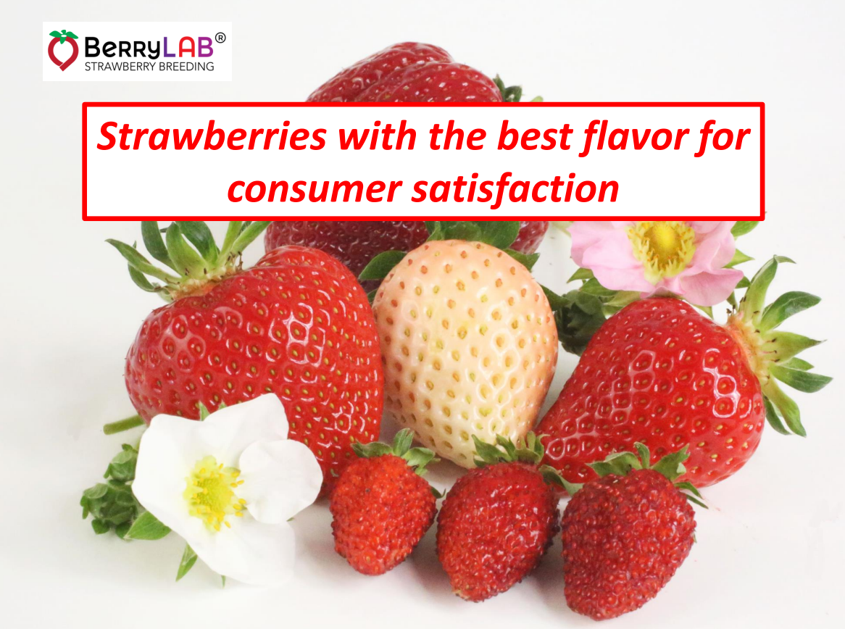

Slide 3
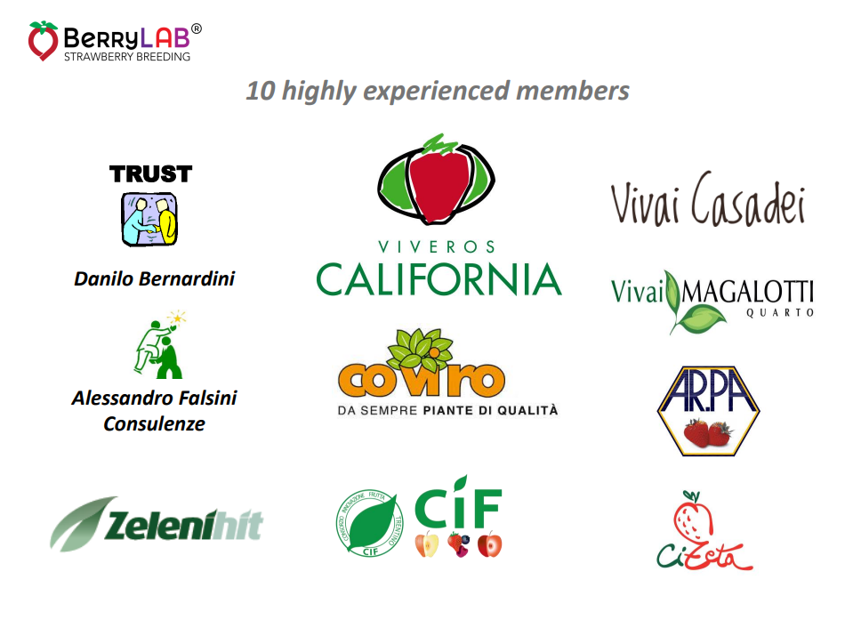

Slide 4
HOW TO CHOOSE THE RIGHT VARIETY
1- CLIMATE AND TECHNICAL CONDITIONS IN WHICH WE OPERATE
2- DISTRIBUTION AND POTENTIAL AVAILABLE MARKET

Slide 5
CLIMATE
TECHNICAL CONDITIONS
CONTINENTAL CLIMATE
Mediterranean
Long spring conditions (high elevation Ethiopia, Mexico)
OPEN FIELD
TUNNELS
GREEN HOUSES
CLIMATE CONTROL

Slide 6
RUSSIA CONTINENTAL CLIMATE
Cold and long winter - short spring - hot summer
SHORT DAYS HIGH CHILLING REQUIREMENT
OPEN FIELD
TUNNELS
GREEN HOUSES

Slide 7
SHORT DAYS VARIETIES
LOW CHILLING REQUIREMENT
  Camarosa
  Marisol
  Candonga
  Sabrina
  Amiga
  Rociera
  Florida Festival
  Florida Fortuna
  Pircinque
HIGH CHILLING REQUIREMENT
  Clery
  Alba
  Sandra
  Arianna
  Nadja
  Brilla
  Asia
  Malling centenary
  Falco
  Elsanta
  Marmolada
  Joly
  Sonsation
  Federica
  Malwina
  ………….

Slide 8
DAY NEUTRAL
CALIFORNIAN
  San Andreas
  Portola
  Albion
  Monterey
  Cabrillo
  Florida Beauty
  Low chilling
EUROPEAN
  Malga
  Brina
  Petra
  Murano
  Vivara
  Favori
  Furore
  ……….
  High chilling

Slide 9
PERFECT GROWN CONDITIONS
CLIMATE CONTROL
12-13°C substrate
5-8°C air minimun temperature
Light 2.500 / 4.000 lux
12 to 14 hours light
CO2
If we can control these growing conditions we can grow every kind of variety

Slide 10
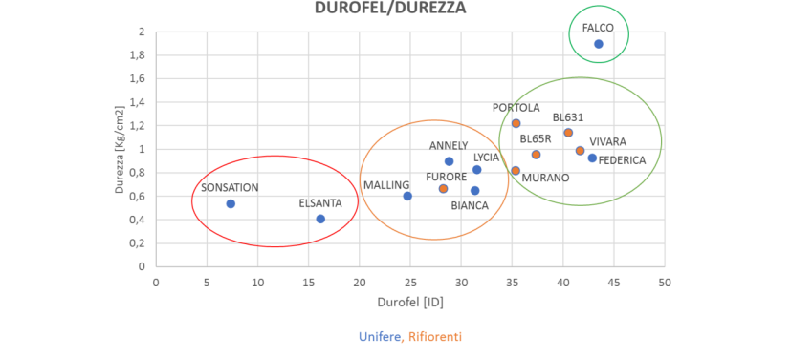

Slide 11
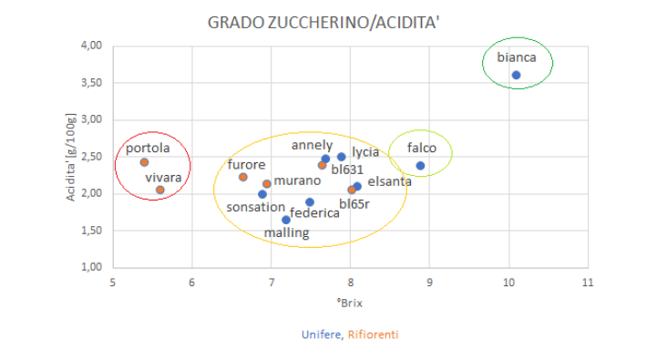

Slide 12
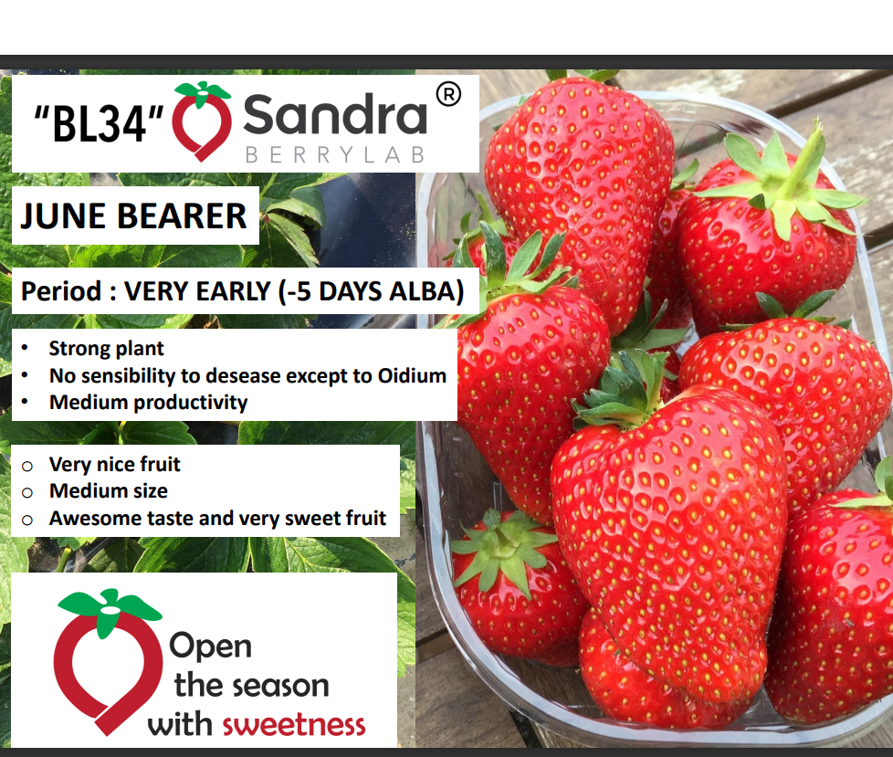

Slide 13
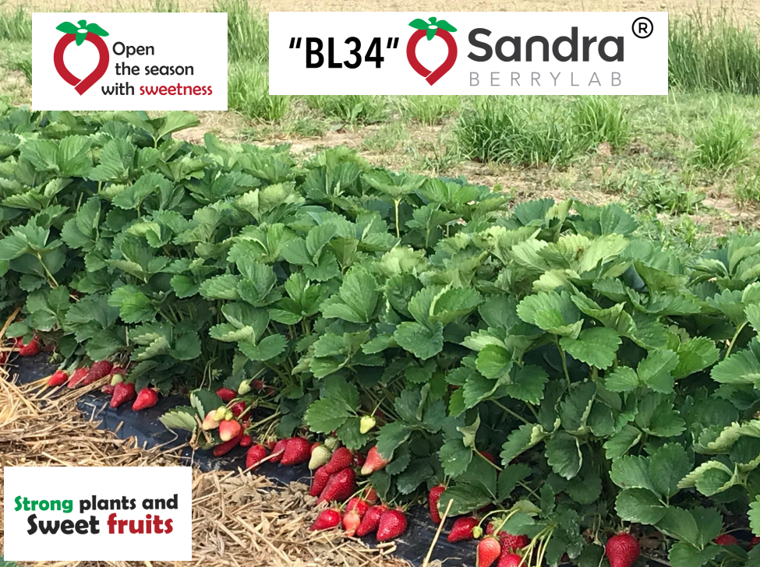

Slide 14
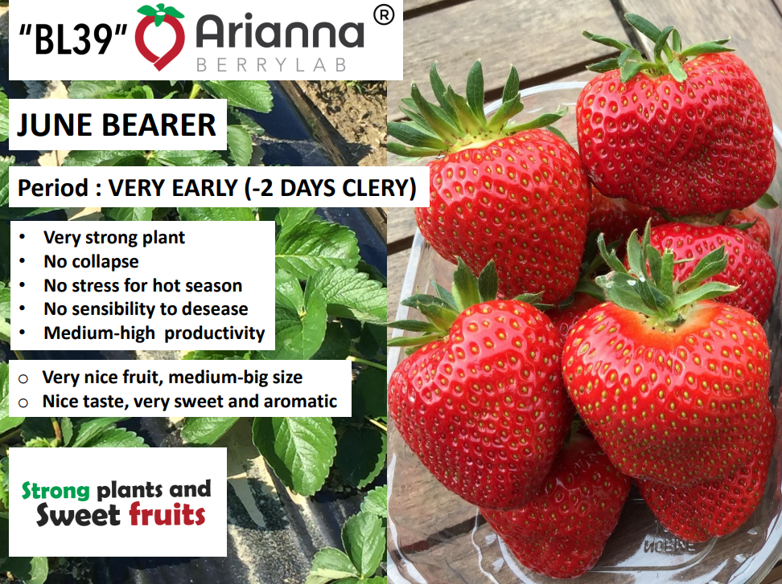

Slide 15
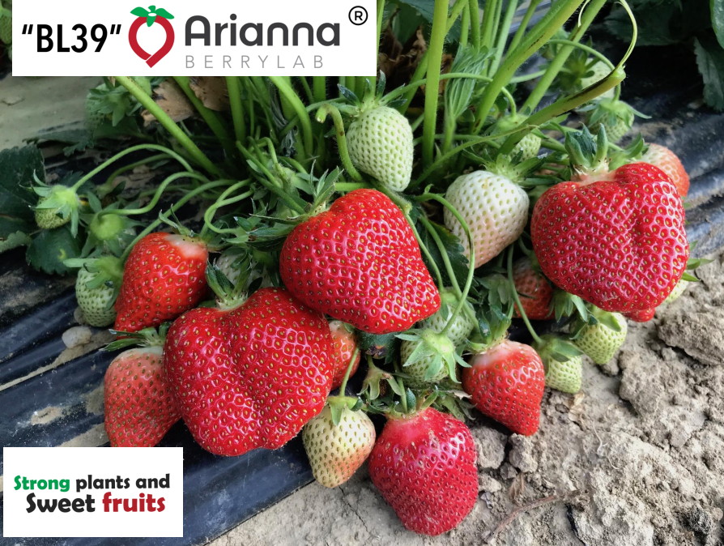

Slide 16
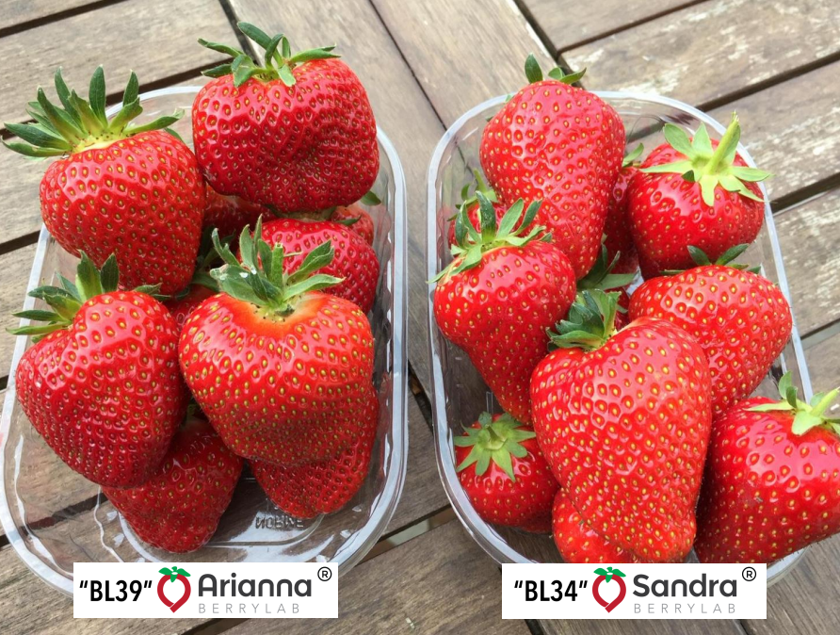

Slide 17
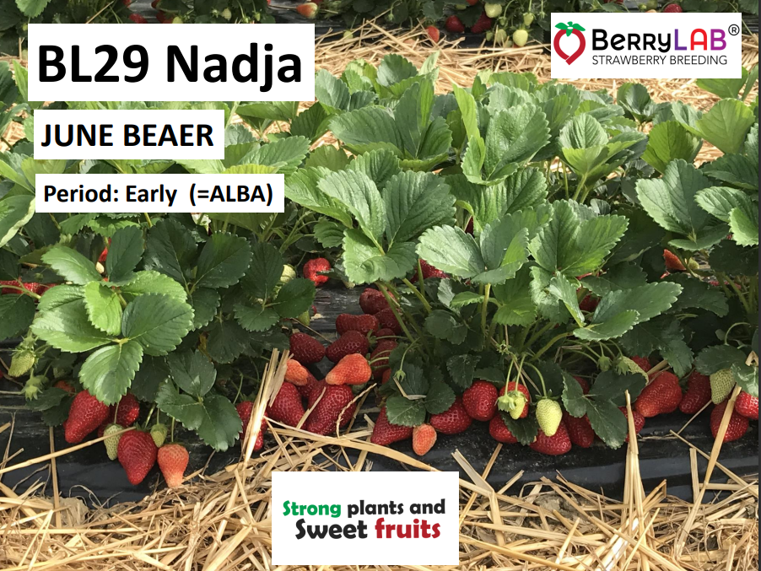

Slide 18
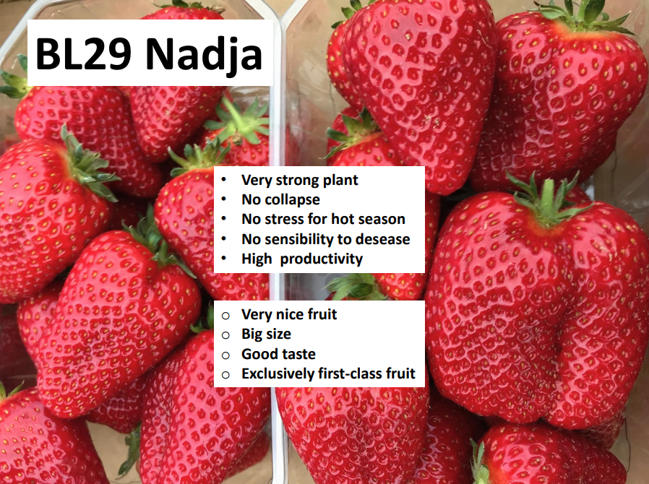

Slide 19
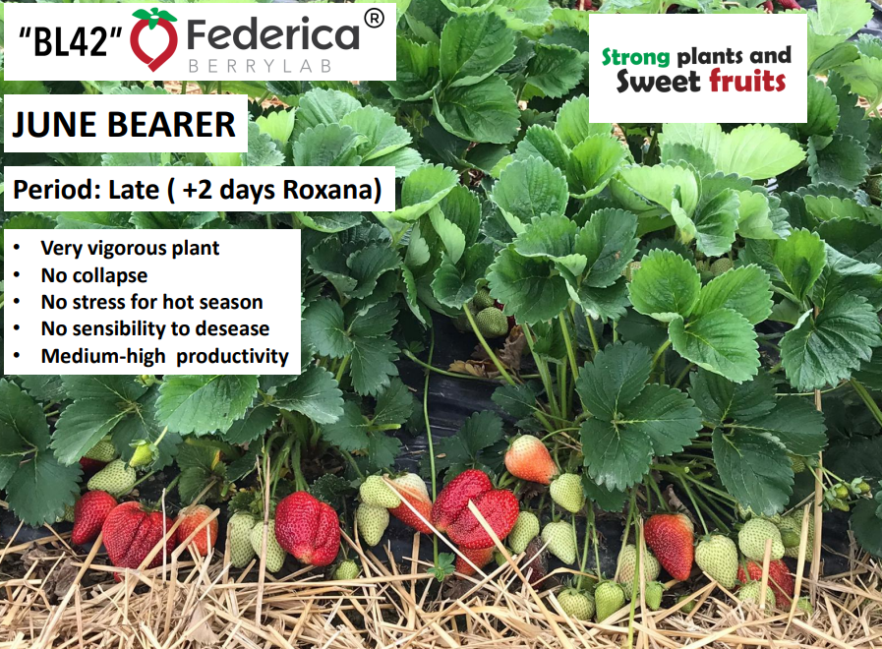

Slide 20
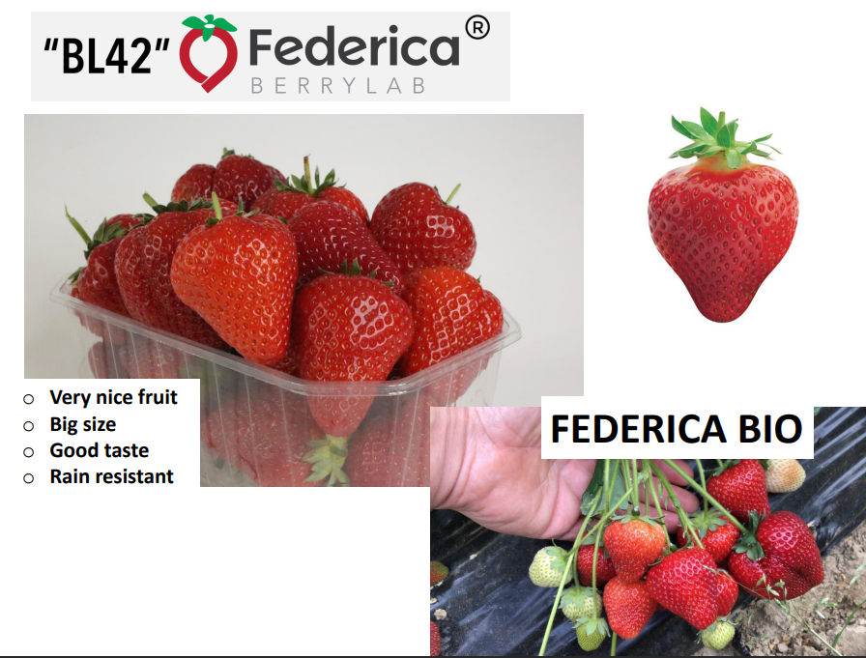

Slide 21


Slide 22
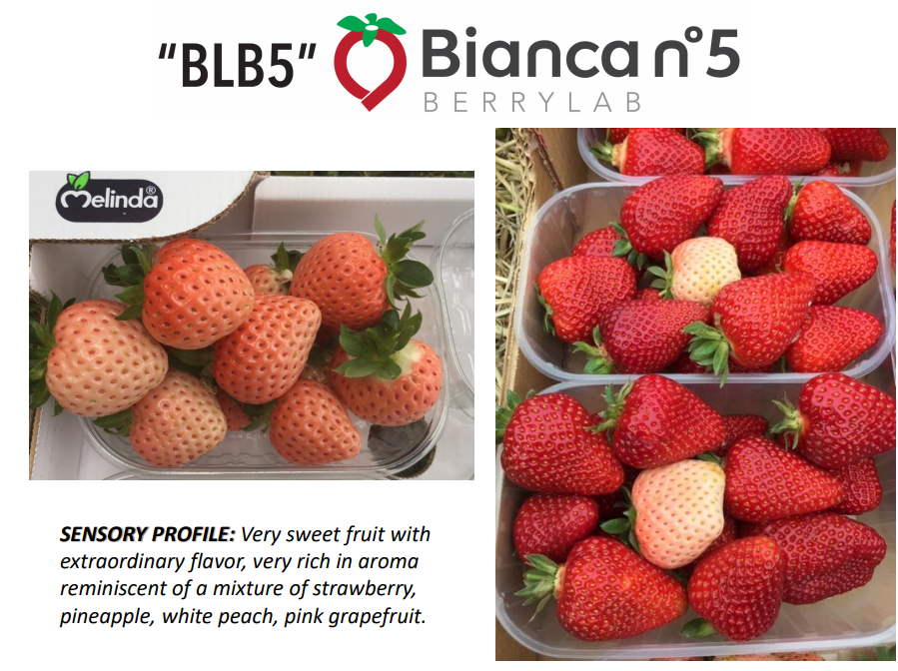

Slide 23
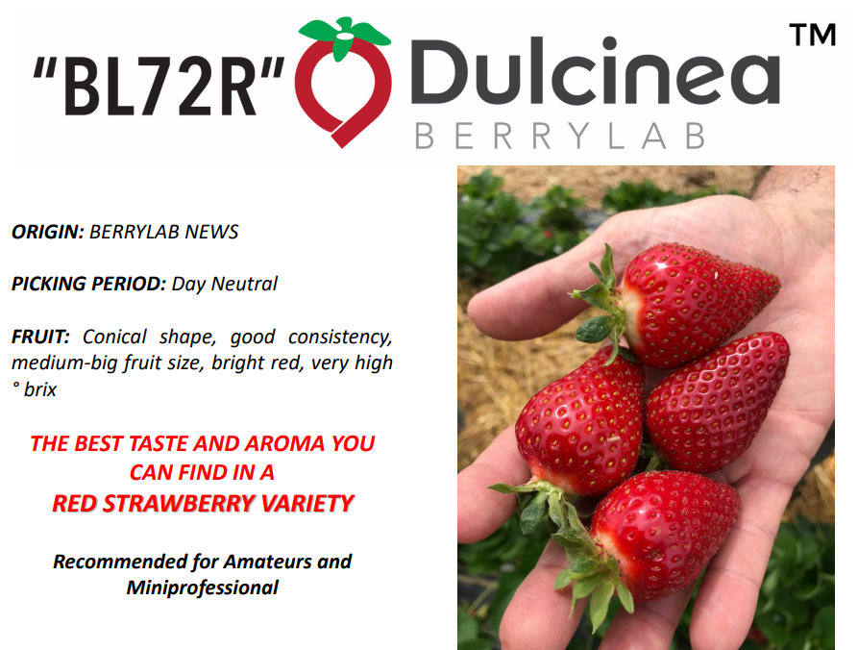

Slide 24
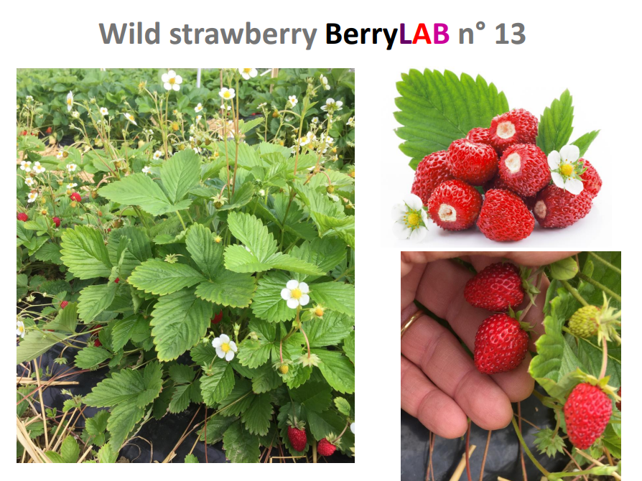

Slide 25
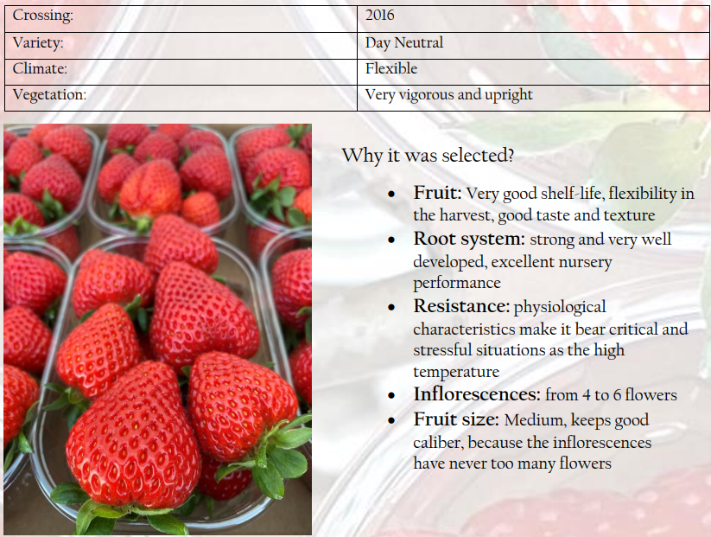
P
E
T
R
A

Slide 26
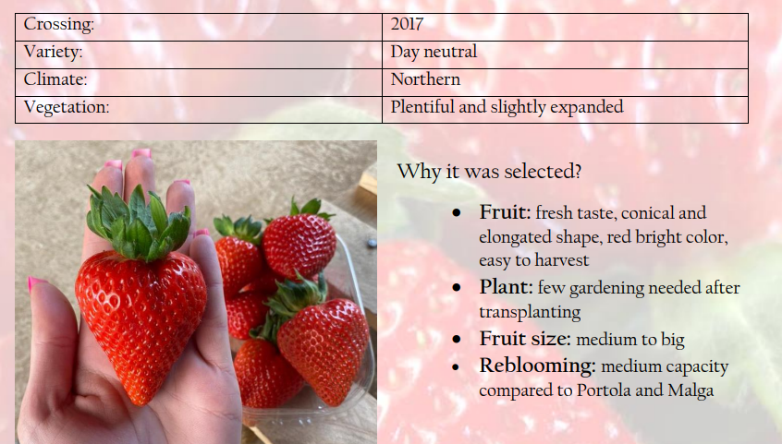
B
R
I
N
A

Slide 27

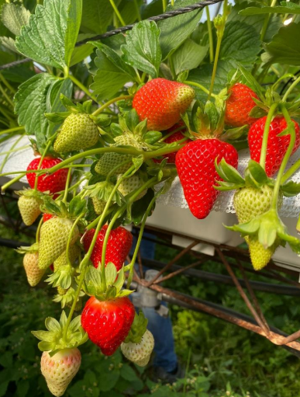

Slide 28
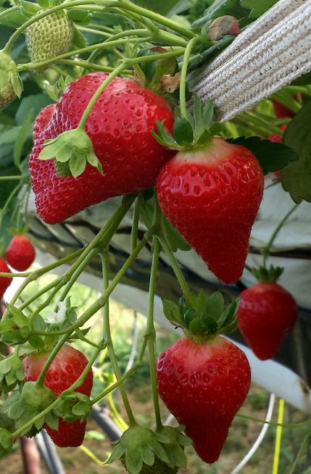
Вопросы?
Контакты докладчика:
FRANCO ZENTI
Mob +39 335 7075022
franco.cizeta@gmail.com

