Slide 1
Organization of harvesting storage and paching blueberries and rasberry

Slide 2
Quality can be defined as a set of internal and external characteristics determined by different market requirements
The quality of the fruit is determined by the following factors:
Fruit appearance (size, shape, color...)
Fruit texture (firmness, juiciness, crispness, flouriness...)
Taste (sweetness, acidity, bitterness, aroma...)
Nutritional value (vitamins, proteins, antioxidants...)
Fruit safety (pesticide contamination, microbiological contamination

Slide 3
Quality parameters are not equal for everyone
Manufacturer
- Good yield, little damage, high yield, resistance to diseases, easy harvest
Wholesalers and traders
- Good appearance, but also strength, long storage period
Consument
- Good appearance, firmness, structure, nutritional value,food safety

Slide 4
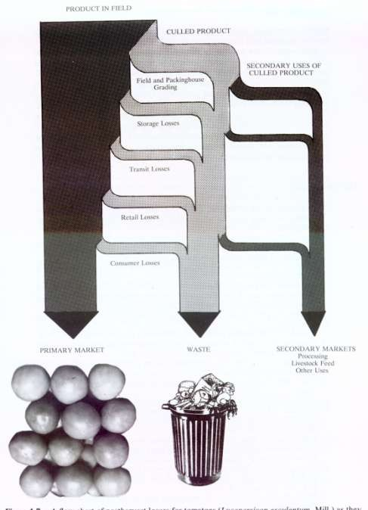

Slide 5
Structure of the fruit:
Pericarp - fruit envelope: exocarp
Mesocarp
Endocarp
Seeds
Real and fake fruits
Parthenocarpy and apomixes
Division of fruits according to the number of flowers:
Monanthocarpic (consists of 1 flower)
Simple - formed from 1 pistil
Aggregate - formed from several pistils of 1 flower
Polyanthocarpic (consists of multiple flowers)fused fruits (pineapple)
Fruits of the inflorescence (fig, mulberry)

Slide 6
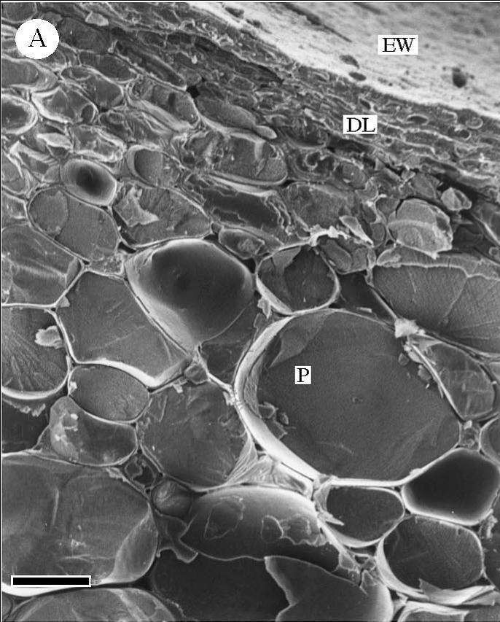
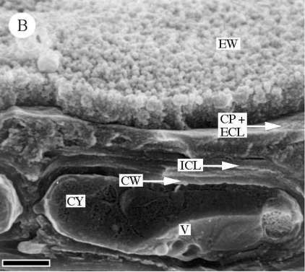
CP-cuticle proper
ECL-external cuticular layer
ICL-internal cuticular layer
CW-cell wall
CY-cytoplasm
V-vacuole

Slide 7
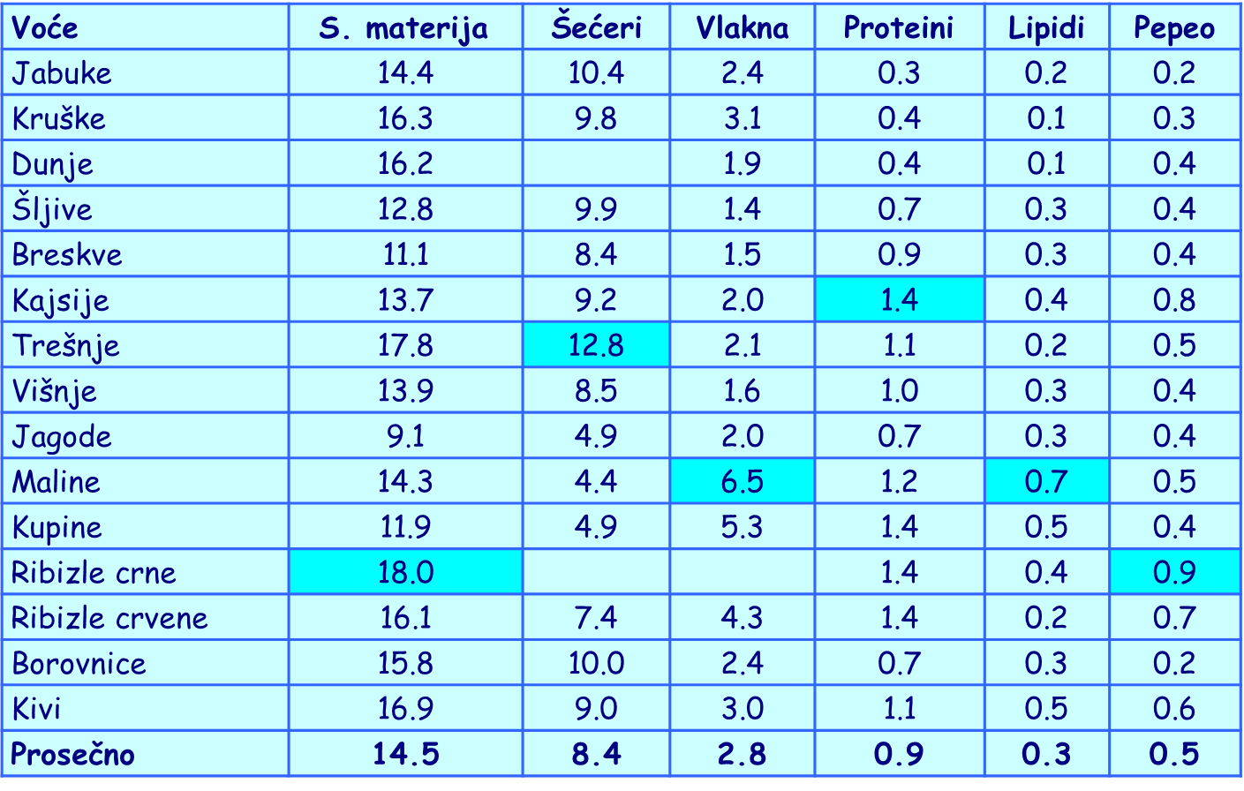

Slide 8
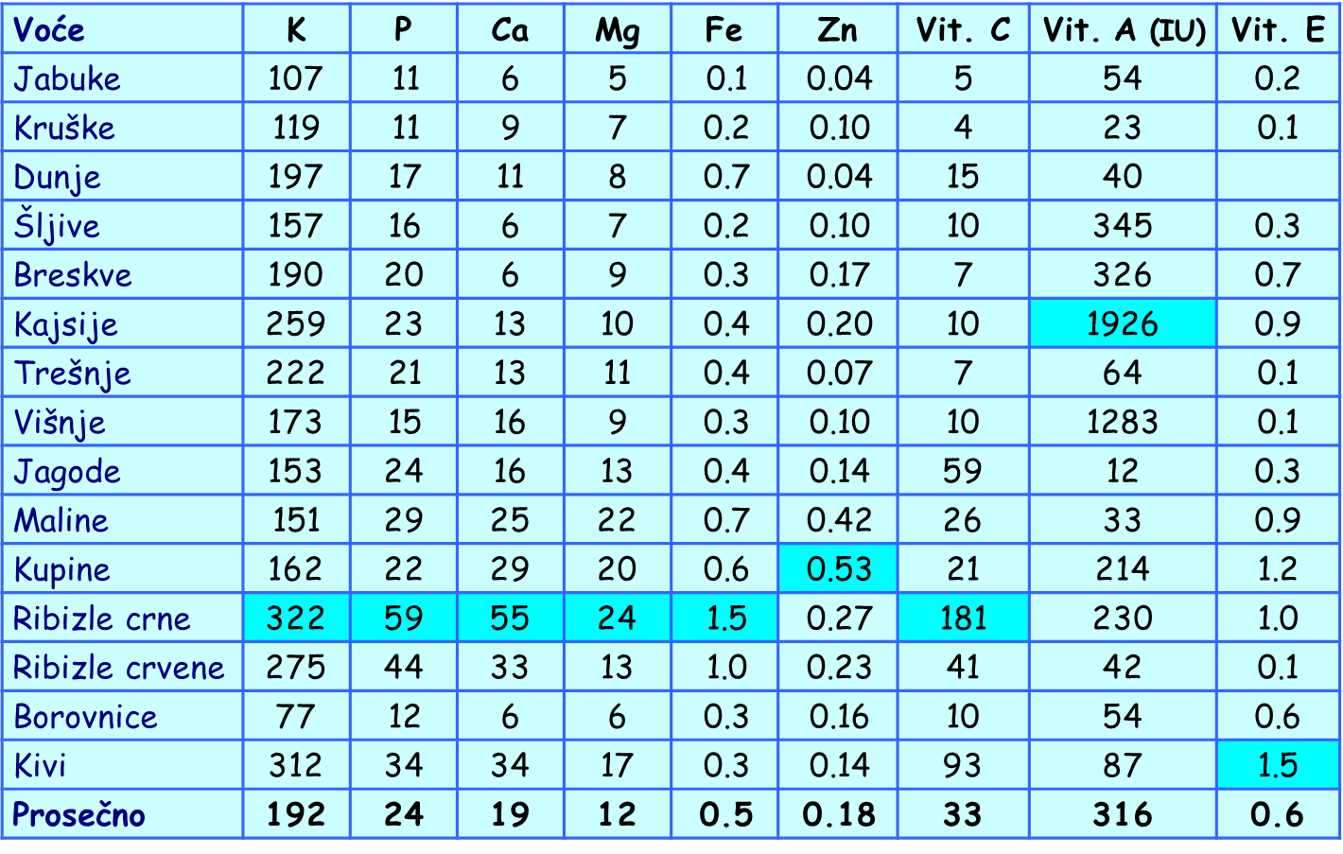

Slide 9
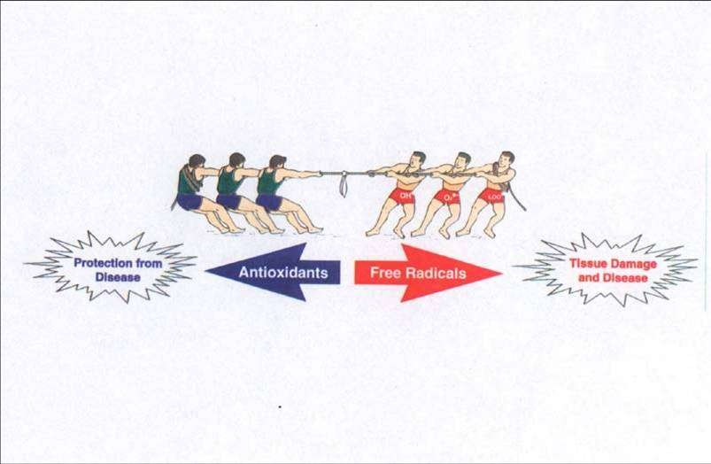

Slide 10
PHYSIOLOGICAL (BOTANICAL) MATURITYT
he seed becomes functionally capableThe fruits reach their maximum sizeA separation layer (abscissa layer) is formed
FULL (CONSUMABLE) MATURITY
The fruits get the best organoleptic propertiesThey are best for fresh consumption
TECHNOLOGICAL MATURITY
It depends on the purpose of the fruitsIt can be between physiological and full maturity

Slide 11
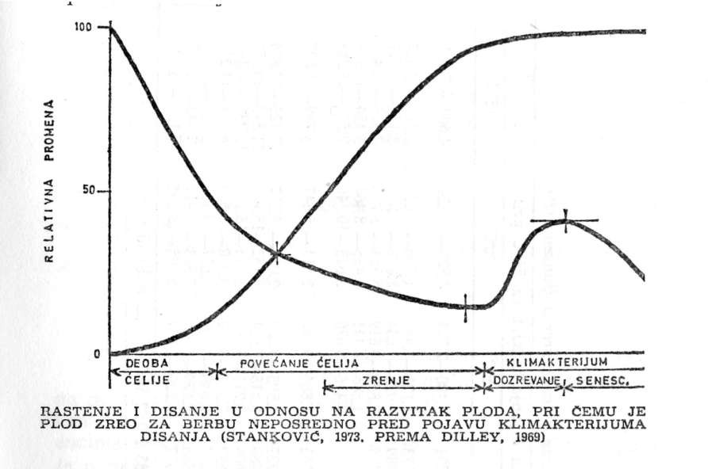

Slide 12
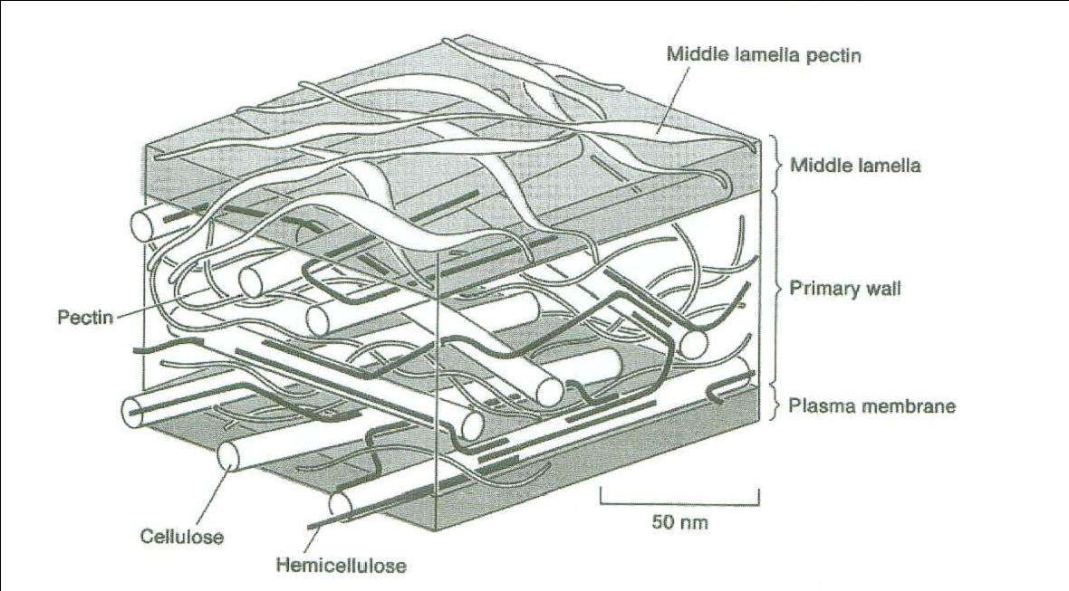

Slide 13
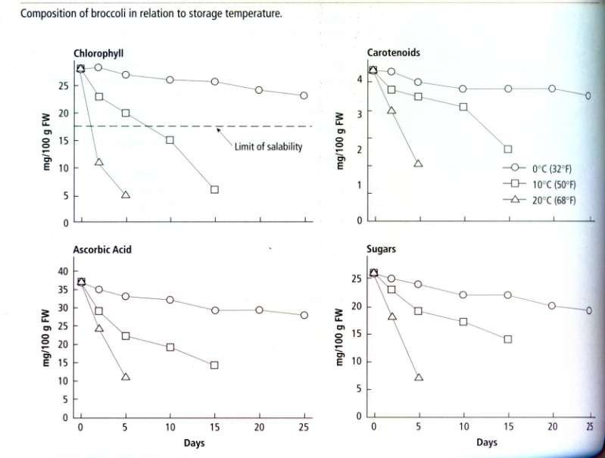

Slide 14
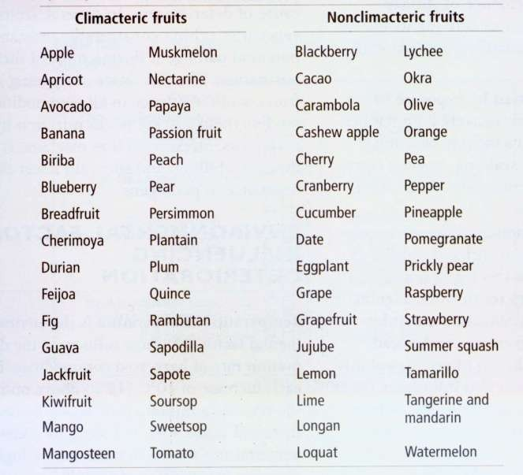

Slide 15
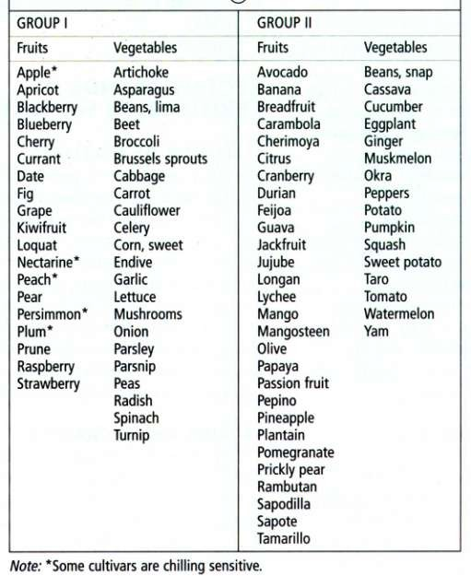
Division of fruits and vegetables based on their sensitivity to lowpositive temperatures

Slide 16
Harvesting and packaging of blueberries and raspberries

Slide 17
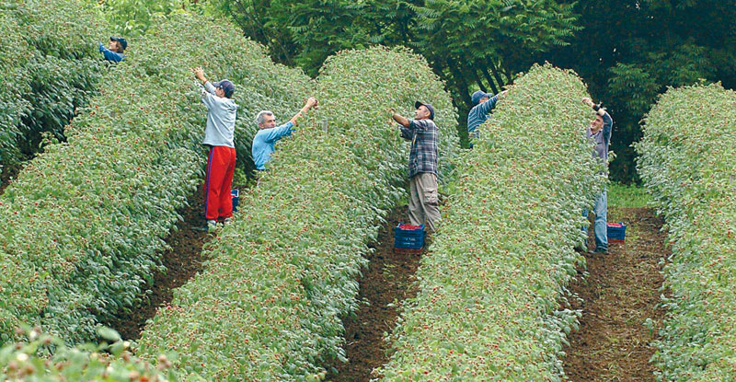
Harvest

Slide 18
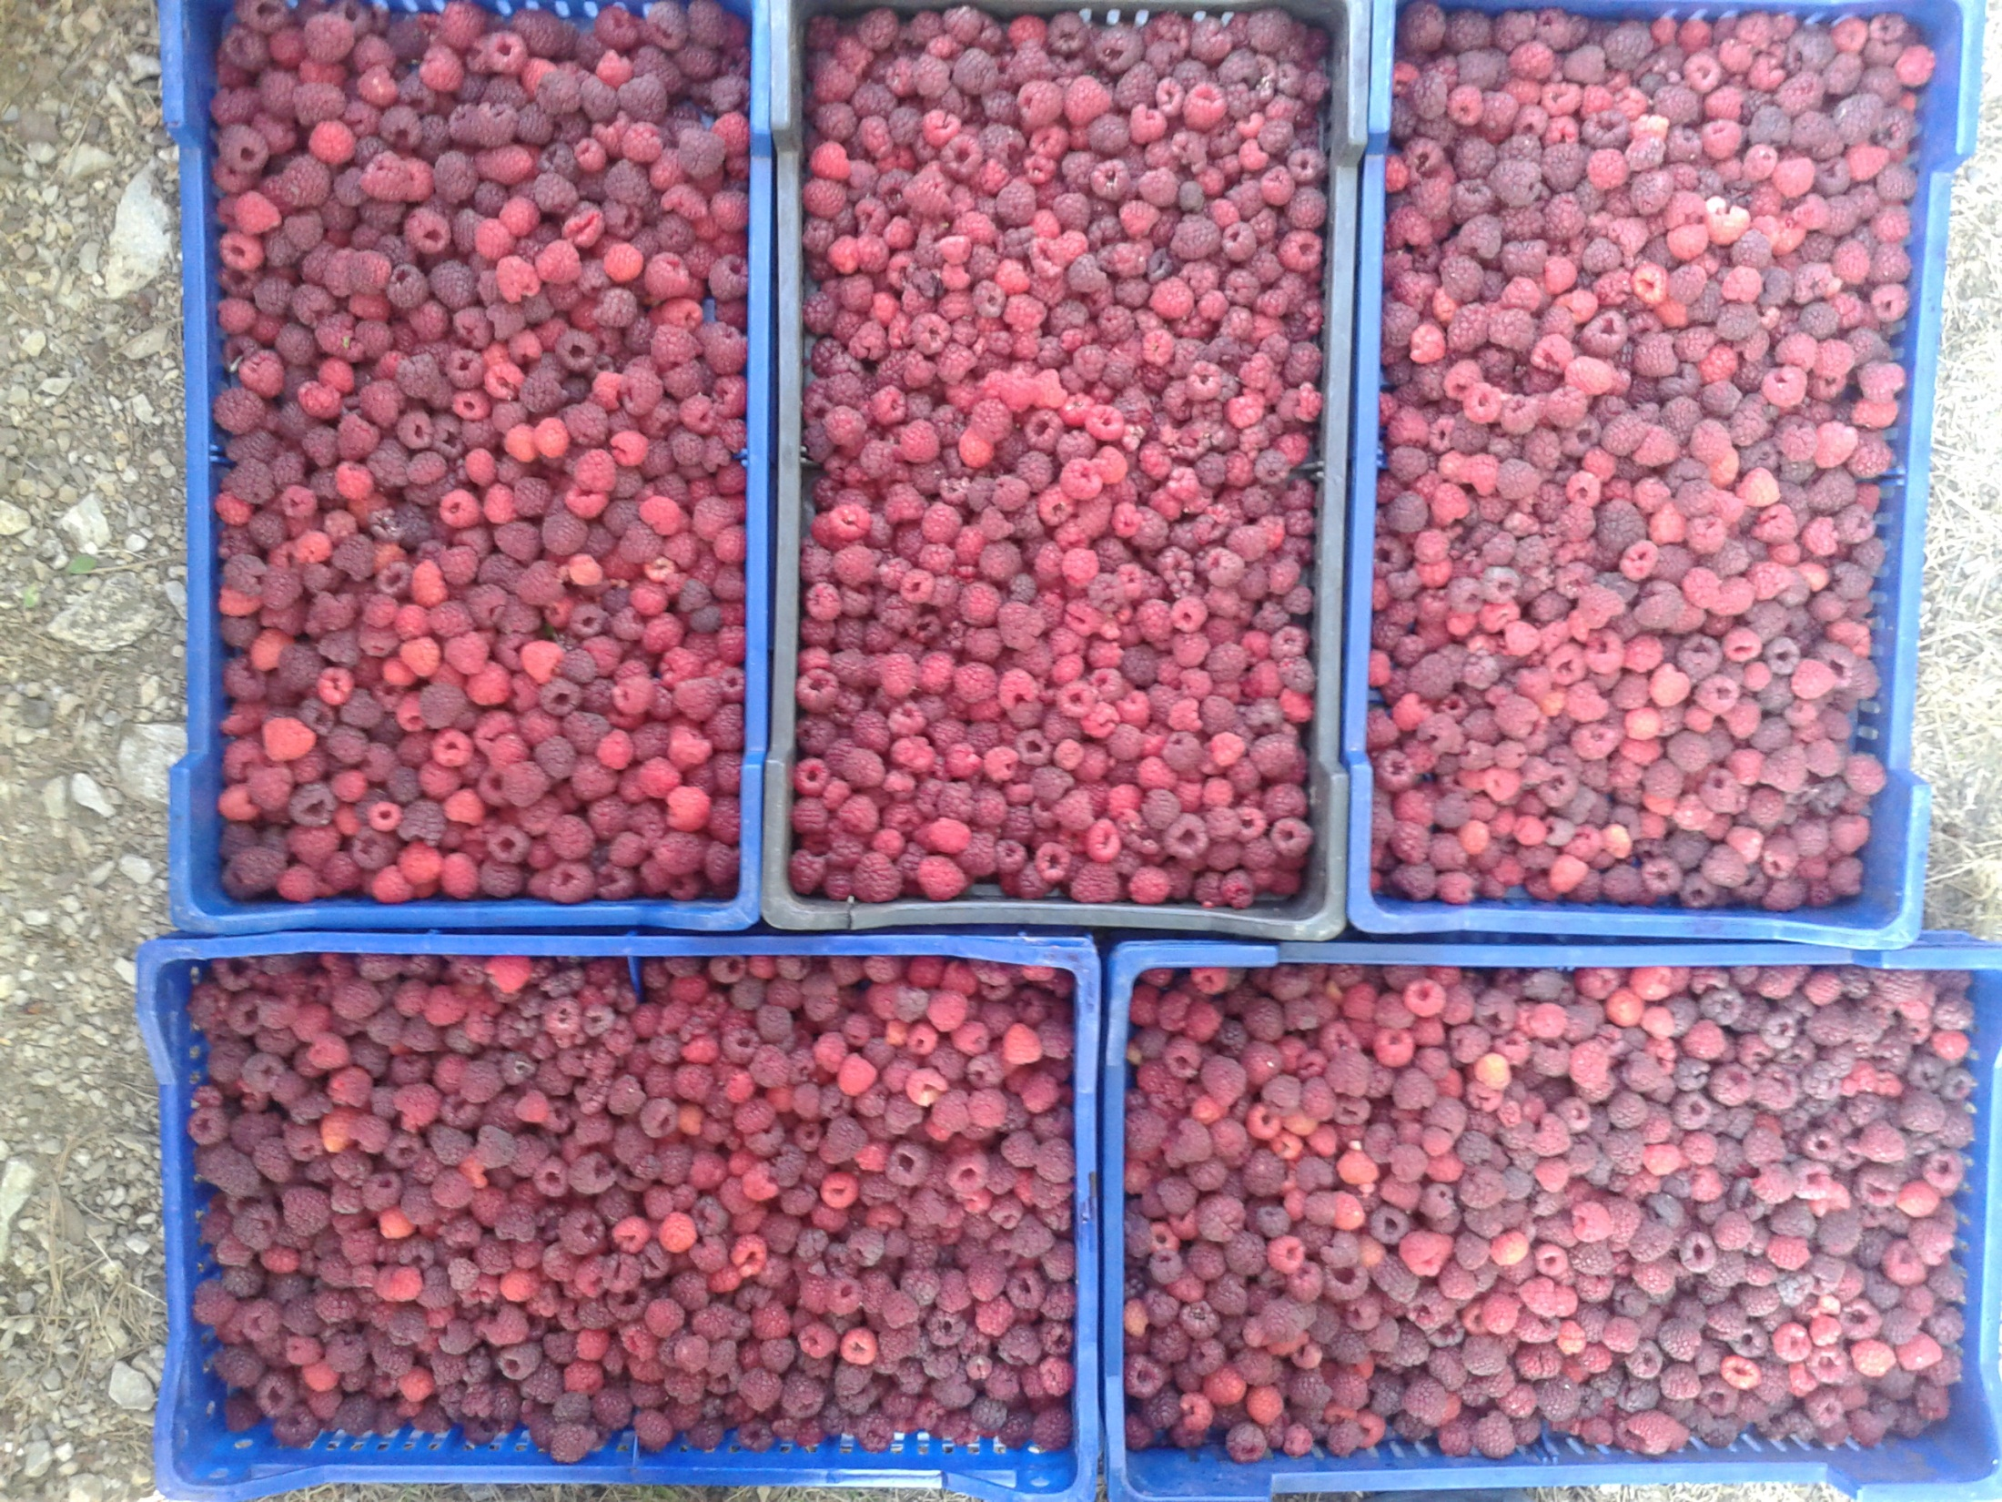

Slide 19
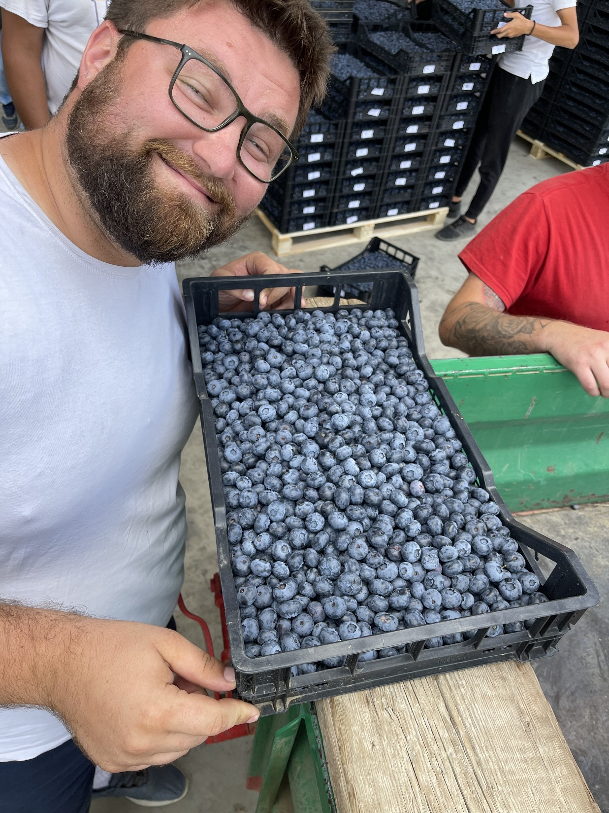

Slide 20
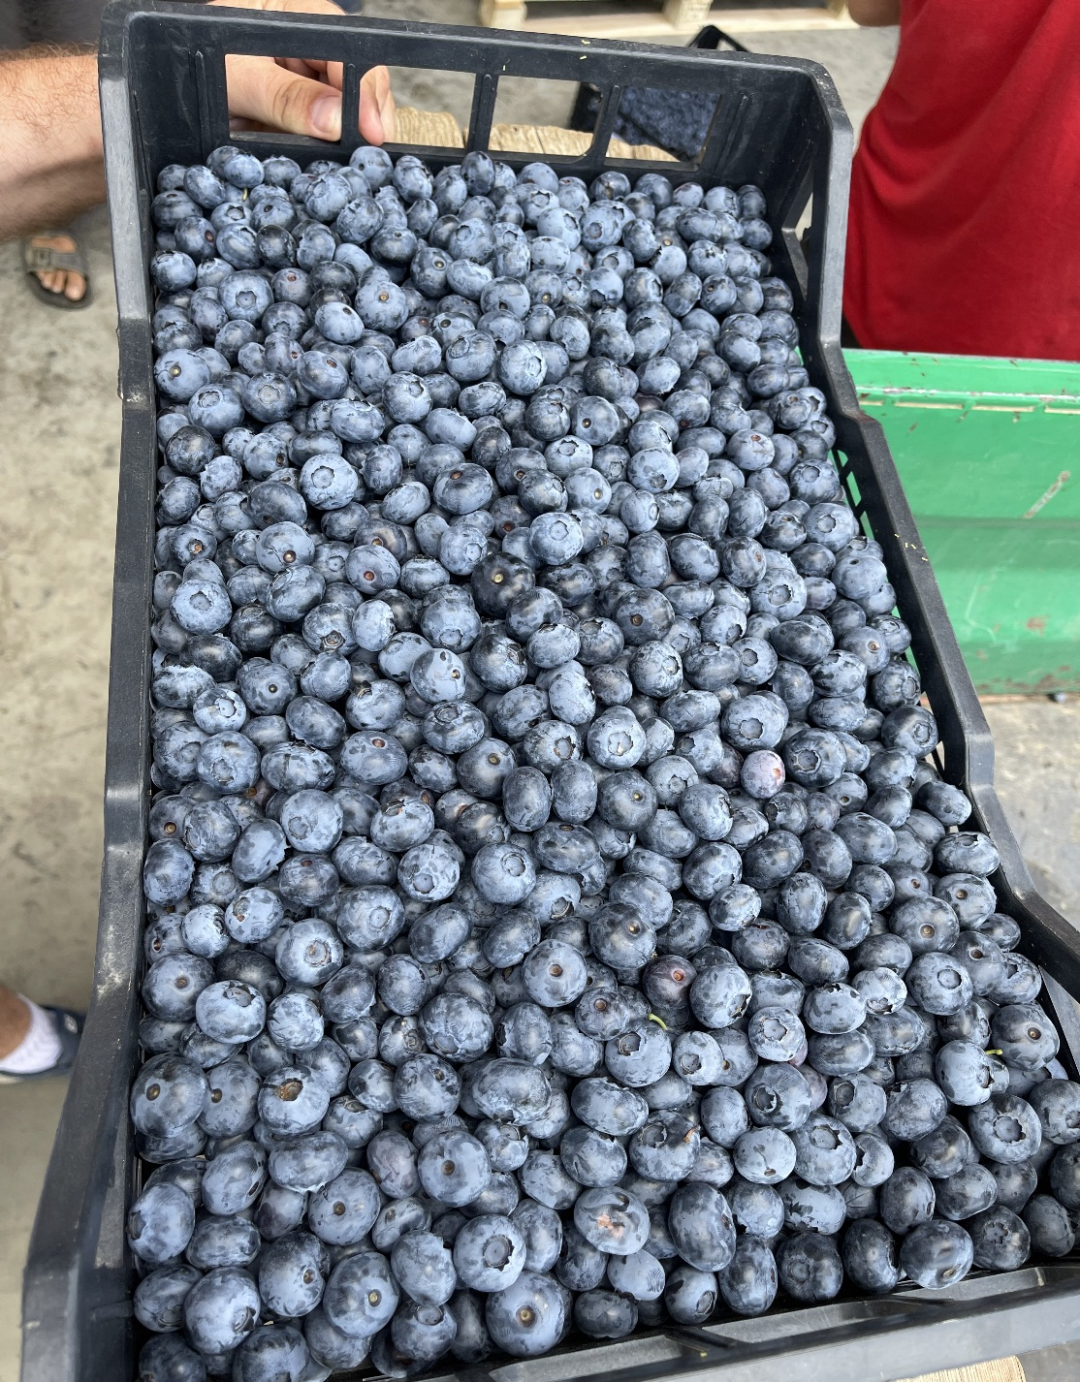
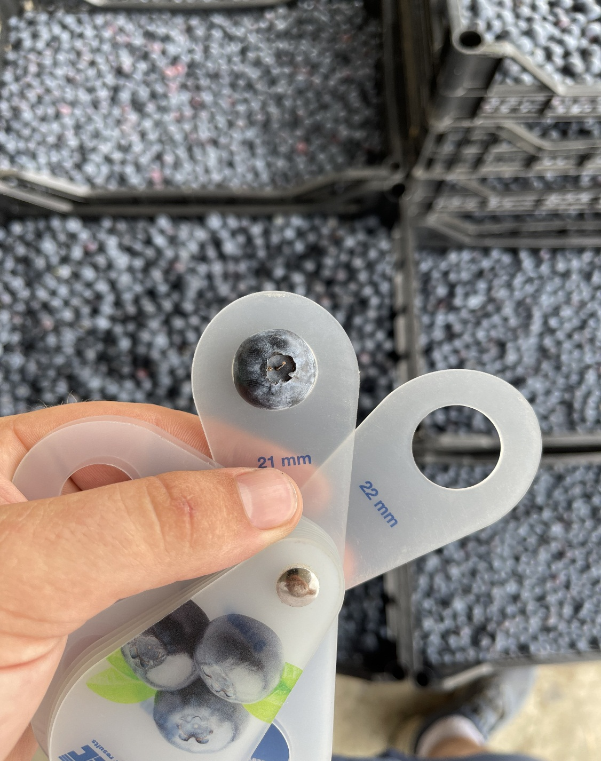

Slide 21
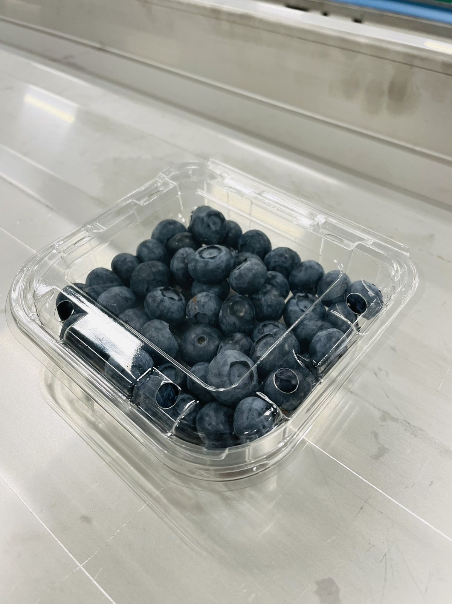
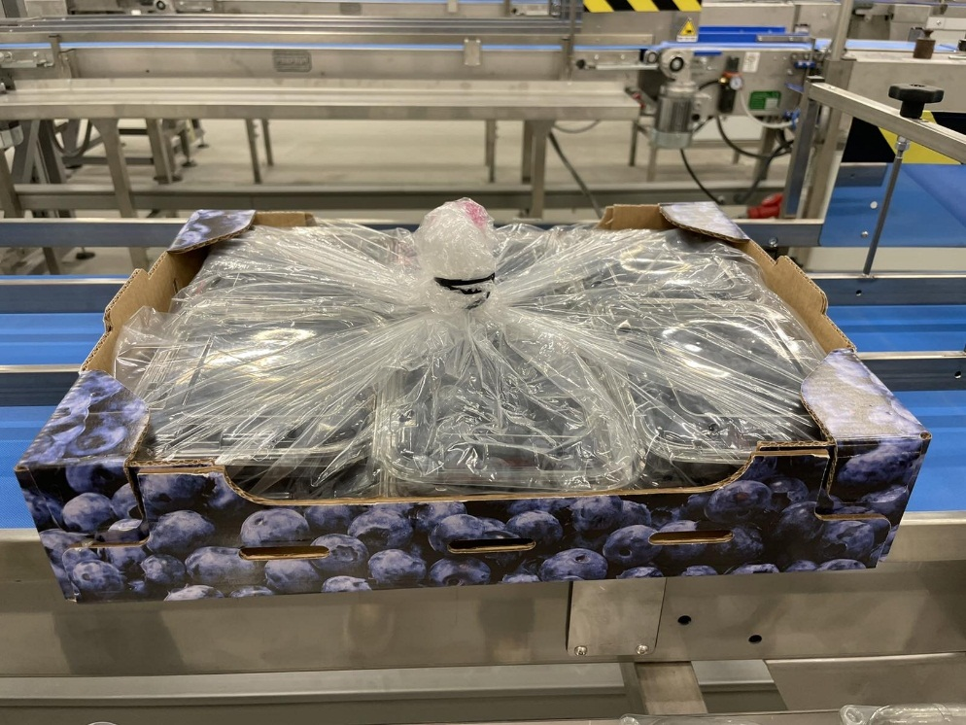
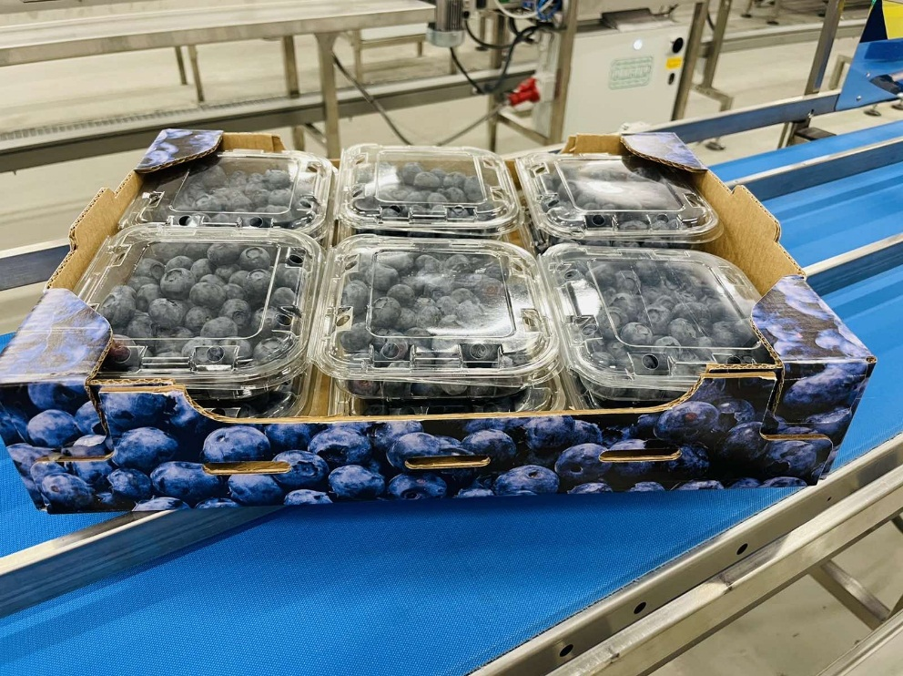

Slide 22
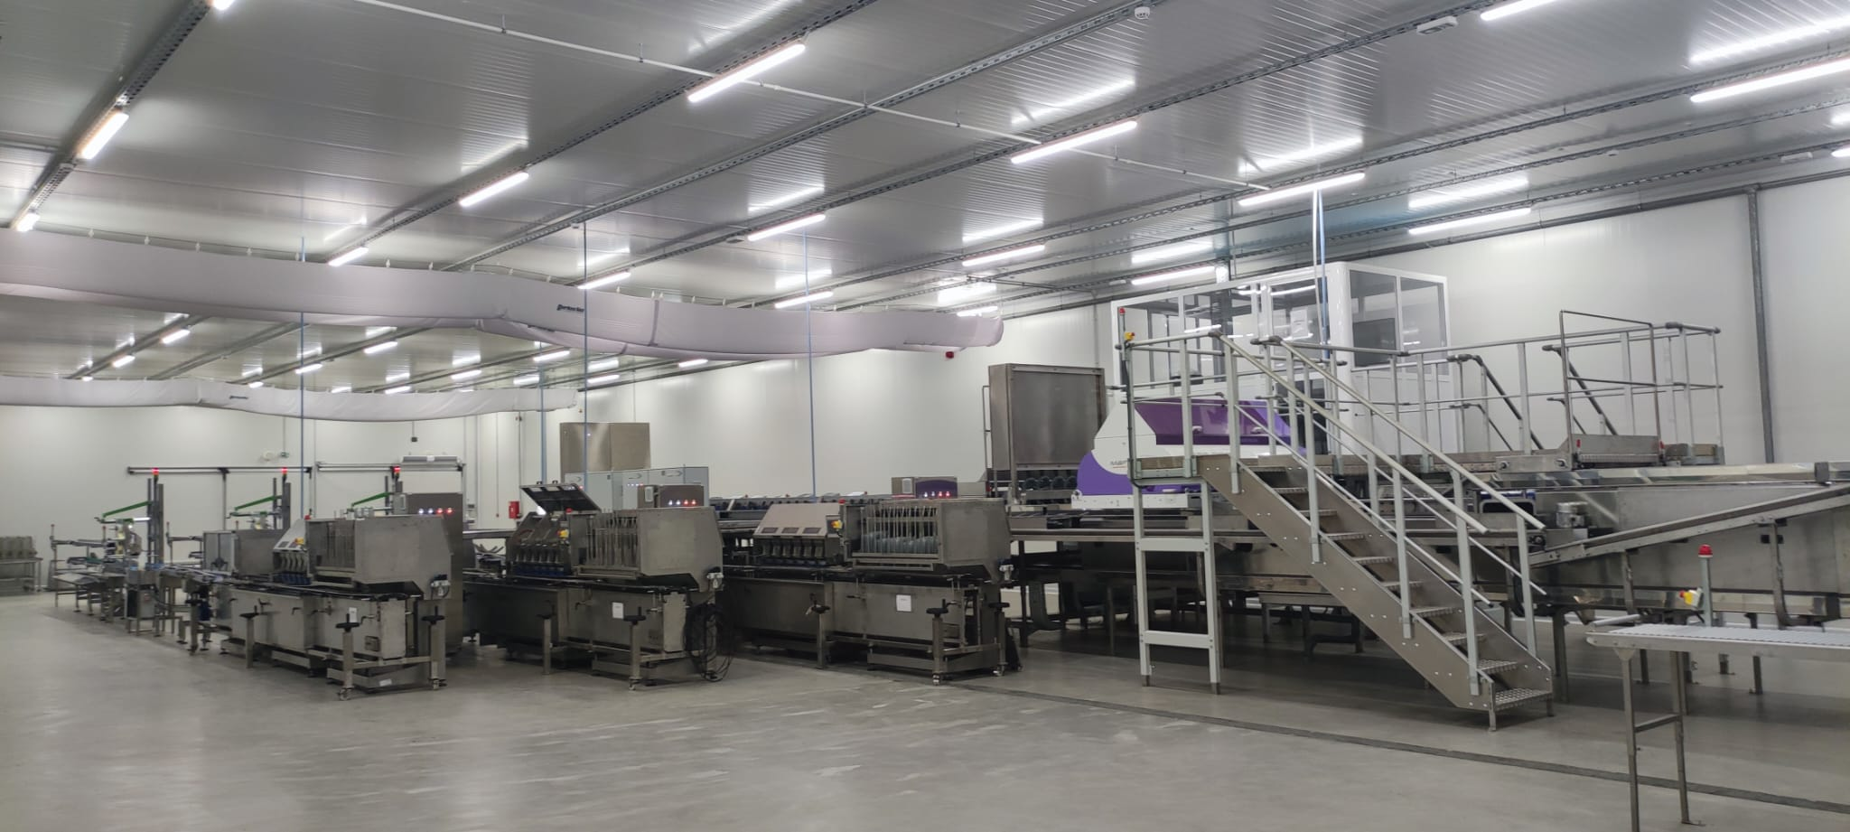

Slide 23
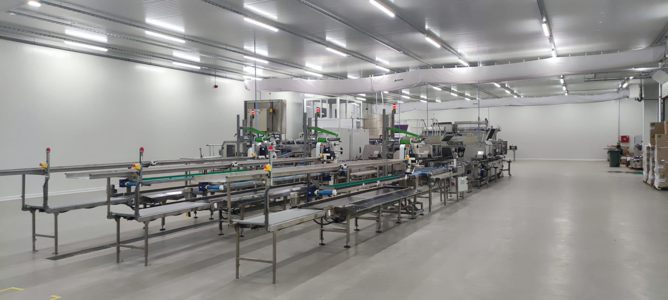

Slide 24
